Slide 1


Defect Taxonomies, Checklist Testing, Error Guessing and Exploratory Testing
Ivan Stanchev
QA Engineer
System Integration Team
Telerik QA Academy

Slide 2

Table of Contents
Defect Taxonomies
Popular Standards and Approaches
An Example of a Defect Taxonomy
Checklist Testing
Error Guessing
Improving Your Error Guessing Techniques
Designing Test Cases
Exploratory Testing

Slide 3


Defect Taxonomies
Using Predefined Lists of Defects

Slide 4


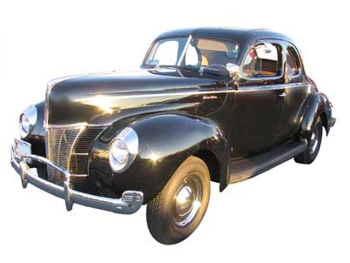



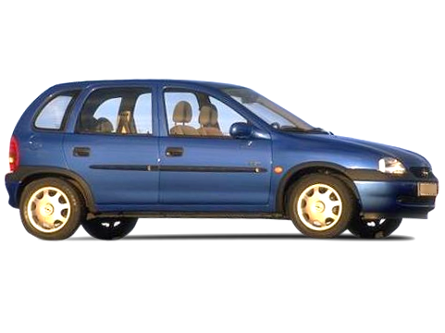

Classify Those Cars!

Slide 5
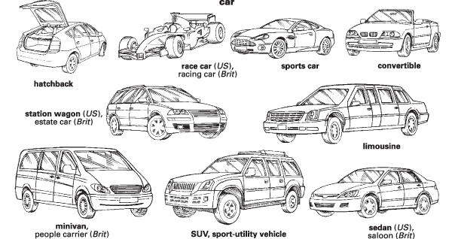
Possible Solution?

Slide 6
Possible Solution? (2)
Black
White
Red
Green
Blue
Another color
Up to 33 kW
34-80 kW
81-120 kW
Above 120 kW
Real
Imaginary

Slide 7
Testing Techniques Chart
Testing
Static
Dynamic
Dynamic analysis
Review
Static Analysis
Black-box
White-box
Experience-based
Defect-based
Functional
Non-functional

Slide 8
Defect Taxonomy
Defect Taxonomy
Many different contexts
Does not have single definition
A system of (hierarchical) categories designed to be a useful aid for reproducibly classifying defects

Slide 9
Defect Taxonomy
A Good Defect Taxonomy for Testing Purposes
Is expandable and ever-evolving
Has enough detail for a motivated, intelligent newcomer to be able to understand it and learn about the types of problems to be tested for
Can help someone with moderate experience in the area (like me) generate test ideas and raise issues

Slide 10
Defect-based Testing
We are doing defect-based testing anytime the type of the defect sought is the basis for the test
The underlying model is some list of defects seen in the past
If this list is organized as a hierarchical taxonomy, then the testing is defect-taxonomy based

Slide 11

The Defect-based Technique
The Defect-based Technique
A procedure to derive and/or select test cases targeted at one or more defect categories
Tests are being developed from what is known about the specific defect category

Slide 12
Defect Based Testing Coverage
Creating a test for every defect type is a matter of risk
Does the likelihood or impact of the defect justify the effort?
Creating tests might not be necessary at all
Sometimes several tests might be required

Slide 13
The Bug Hypothesis
The underlying bug hypothesis is that programmers tend to repeatedly make the same mistakes
I.e., a team of programmers will introduce roughly the same types of bugs in roughly the same proportion from one project to the next
Allows us to allocate test design and execution effort based on the likelihood and impact of the bugs

Slide 14
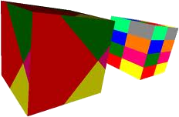
Practical Implementation
Most practical implementation of defect taxonomies is Brainstorming of Test Ideas in a systematic manner
How does the functionality fail with respect to each defect category?
They need to be refined or adapted to the specific domain and project environment

Slide 15

An Example of a Defect Taxonomy

Slide 16
Example of a Defect Taxonomy
Here we can review an example of a Defect taxonomy
Provided by Rex Black
See "Advanced Software Testing Vol. 1" (ISBN: 978-1-933952-19-2)
The example is focused on the root causes of bugs

Slide 17
Exemplary Taxonomy Categories
Functional
Specification
Function
Test

Slide 18
Exemplary Taxonomy Categories (2)
System
Internal Interfaces
Hardware Devices
Operating System
Software Architecture
Resource Management

Slide 19
Exemplary Taxonomy Categories (3)
Process
Arithmetic
Initialization
Control of Sequence
Static Logic
Other

Slide 20
Exemplary Taxonomy Categories (4)
Data
Type
Structure
Initial Value
Other
Code
Documentation
Standards

Slide 21
Exemplary Taxonomy Categories (5)
Other
Duplicate
Not a Problem
Bad Unit
Root Cause Needed
Unknown

Slide 22
Testing Techniques Chart
Testing
Static
Dynamic
Dynamic analysis
Review
Static Analysis
Black-box
White-box
Experience-based
Defect-based
Functional
Non-functional

Slide 23
Experience-based Techniques
Tests are based on people's skills, knowledge, intuition and experience with similar applications or technologies
Knowledge of testers, developers, users and other stakeholders
Knowledge about the software, its usage and its environment
Knowledge about likely defects and their distribution

Slide 24


Checklist Testing

Slide 25
What is Checklist Testing?
Checklist-based testing involves using checklists by testers to guide their testing
The checklist is basically a high-level list (guide or a reminder list) of:
issues to be tested
Items to be checked
Lists of rules
Particular criteria
Data conditions to be verified

Slide 26
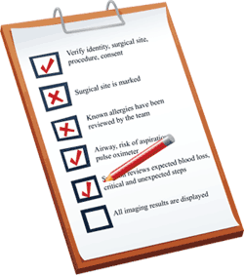
What is Checklist Testing? (2)
Checklists are usually developed over time on the base of:
The experience of the tester
Standards
Previous trouble-areas
Known usage

Slide 27
The Bug Hypothesis
The underlying bug hypothesis in checklist testing is that bugs in the areas of the checklist are likely, important, or both
So what is the difference with quality risk analysis?
The checklist is predetermined rather than developed by an analysis of the system

Slide 28
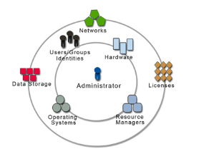
Theme Centered Organization
A checklist is usually organized around a theme
Quality characteristics
User interface standards
Key operations
Etc.

Slide 29
Checklist Testing in Methodical Testing
The list should not be a static
Generated at the beginning of the project
Periodically refreshed during the project through some sort of analysis, such as quality risk analysis

Slide 30

Exemplary Checklist
A checklist for usability of a system could be:
Simple and natural dialog
Speak the user's language
Minimize user memory load
Consistency
Feedback

Slide 31

Exemplary Checklist (2)
A checklist for usability of a system could be:
Clearly marked exits
Shortcuts
Good error messages
Prevent errors
Help and documentation

Slide 32
Real-Life Example
A good example for real-life checklist:
http://www.eply.com/help/eply-form-testing-checklist.pdf
Usability checklist:
http://userium.com/

Slide 33
Advantages of Checklist Testing
Checklists can be reused
Saving time and energy
Help in deciding where to concentrate efforts
Valuable in time-pressure circumstances
Prevents forgetting important issues
Offers a good structured base for testing
Helps spreading valuable ideas for testing among testers and projects

Slide 34
Recommendations
Checklists should be tailored according to the specific situation
Use checklists as an aid, not as mandatory rule
Standards for checklists should be flexible
Evolving according to the new experience

Slide 35

Error Guessing
Using the Tester's Intuition

Slide 36
What is Error Guessing?
It is not actually guessing. Good testers do not guess…
They build hypothesis where a bug might exist based on:
Previous experience
Early cycles
Similar systems
Understanding of the system under test
Design method
Implementation technology
Knowledge of typical implementation errors

Slide 37

Gray Box Testing
Error Guessing can be called Gray box testing
Requires the tester to have some basic programming understanding
Typical programming mistakes
How those mistakes become bugs
How those bugs manifest themselves as failures
How can we force failures to happen

Slide 38
Objectives of Error Guessing
Focus the testing activity on areas that have not been handled by the other more formal techniques
E.g., equivalence partitioning and boundary value analysis
Intended to compensate for the inherent incompleteness of other techniques
Complement equivalence partitioning and boundary value analysis

Slide 39
Experience Required
Testers who are effective at error guessing use a range of experience and knowledge:
Knowledge about the tested application
E.g., used design method or implementation technology
Knowledge of the results of any earlier testing phases
Particularly important in Regression Testing

Slide 40

Experience Required (2)
Testers who are effective at error guessing use a range of experience and knowledge:
Experience of testing similar or related systems
Knowing where defects have arisen previously in those systems
Knowledge of typical implementation errors
E.g., division by zero errors
General testing rules

Slide 41
More Practical Definition
Error guessing involves asking
"What if…"

Slide 42
How to Improve Your Error Guessing Techniques?
Improve your technical understanding
Go into the code, see how things are implemented
Learn about the technical context in which the software is running, special conditions in your OS, DB or web server
Talk with Developers

Slide 43

How to Improve Your Error Guessing Techniques? (2)
Look for errors not only in the code, but also:
Errors in requirements
Errors in design
Errors in coding
Errors in build
Errors in testing
Errors in usage

Slide 44

Effectiveness
Different people with different experience will show different results
Different experiences with different parts of the software will show different results
As tester advances in the project and learns more about the system, he/she may become better in Error Guessing

Slide 45
Why using it?
Advantages of Error Guessing
Highly successful testers are very effective at quickly evaluating a program and running an attack that exposes defects
Can be used to complement other testing approaches
It is more a skill then a technique that is well worth cultivating
It can make testing much more effective

Slide 46
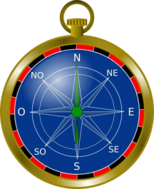
Exploratory Testing
Learn, Test and Execute Simultaneously

Slide 47

What is Exploratory Testing?
What is Exploratory Testing?
Simultaneous test design, test execution, and learning.
James Bach, 1995

Slide 48
What is Exploratory Testing? (2)
What is Exploratory Testing?
Simultaneous test design, test execution, and learning, with an emphasis on learning.
Cem Kaner, 2005
The term "exploratory testing" is coined by Cem Kaner in his book "Testing Computer Software"

Slide 49
What is Exploratory Testing?
What is Exploratory Testing?
A style of software testing that emphasizes the personal freedom and responsibility of the individual tester to continually optimize the quality of his/her work by treating test-related learning, test design, test execution, and test result interpretation as mutually supportive activities that run in parallel throughout the project.
2007

Slide 50

What is Exploratory Testing? (3)
Exploratory testing is an approach to software testing involving simultaneous exercising the three activities:
Learning
Test design
Test execution

Slide 51
Control as You Test
In exploratory testing, the tester controls the design of test cases as they are performed
Rather than days, weeks, or even months before
Information the tester gains from executing a set of tests then guides the tester in designing and executing the next set of tests

Slide 52

When Do We Use ET?
When do we use exploratory testing (ET)?
Anytime the next test we do is influenced by the result of the last test we did
We become more exploratory when we can't tell what tests should be run, in advance of the test cycle

Slide 53

Exploratory vs. Ad hoc Testing
Exploratory testing is to be distinguished from ad hoc testing
The term "ad hoc testing" is often associated with sloppy, careless, unfocused, random, and unskilled testing

Slide 54

Is This a Technique?
Exploratory testing is not a testing technique
It’s a way of thinking about testing
Capable testers have always been performing exploratory testing
Widely misunderstood and foolishly disparaged
Any testing technique can be used in an exploratory way

Slide 55
Scripted Testing vs. Exploratory
We can say the opposite of exploratory testing is scripted testing
A Script (low level test case) specifies:
the test operations
the expected results
the comparisons the human or machine should make
These comparison points are useful in general, but many times fallible and incomplete, criteria for deciding whether the program behaves properly
Scripts require a big investment

Slide 56
Scripted Testing vs. Exploratory
In contrast with scripting exploratory testing:
Execute the test at time of design
Design the test as needed
Vary the test as appropriate
The exploratory tester is always responsible for managing the value of her own:
Reusing old tests
Creating and running new tests
Creating test-support artifacts, such as failure mode lists
Conducting background research that can then guide test design

Slide 57
Scripted vs. Exploratory Testing
Scripted Testing | Exploratory Testing
Directed from elsewhere | Directed from within
Determined in advance | Determined in the moment
Is about confirmation | Is about investigation
Is about controlling tests | Is about improving test design
Emphasizes predictability | Emphasizes adaptability
Emphasizes decidability | Emphasizes learning
Like making a speech | Like having a conversation
Like playing from a score | Like playing in a jam session

Slide 58
Issues with Exploratory Testing
Depends heavily on the testing skills and domain knowledge of the tester
Limited test reusability
Limited test reusability
Limited reproducibility of failures
Cannot be managed
Low Accountability
Most of them are myths!

Slide 59
Session-Based Test Management
Software test method that aims to combine accountability and exploratory testing to provide rapid defect discovery, creative on-the-fly test design, management control and metrics reporting

Slide 60
Session-Based Test Management
Elements:
Charter - A charter is a goal or agenda for a test session
Session - An uninterrupted period of time spent testing
Session report - The session report records the test session
Debrief - A debrief is a short discussion between the manager and tester (or testers) about the session report

Slide 61
Session-Based Test Management
CHARTER
Analyze View menu functionality and report on areas of potential risk
AREAS
OS | Windows 7Menu | View Strategy | Function
Testing Start: 08.07.2013 10:00
End: 07.08.2013 11:00
Tester:

Slide 62
Session-Based Test Management
TEST NOTES
I touched each of the menu items, below, but focused mostly on zooming behavior with various combinations of map elements displayed.
View: Welcome Screen, Navigator, Locator Map, Legend, Map Elements Highway Levels, Zoom
Levels Risks:- Incorrect display of a map element.- Incorrect display due to interrupted
BUGS
#BUG 1321 Zooming in makes you put in the CD 2 when you get to acerta in level of granularity (the street names level) --even if CD 2 is already in the drive.
ISSUES
How do I know what details should show up at what zoom levels?

Slide 63
Scripted vs. Exploratory
Testing usually falls in between the both sides:
Depends on the context of the project
Role-based sandboxes
Vague scripts
Fragment test cases (scenarios)
Pure scripted
Charters
Freestyle

Slide 64
References
Testing Computer Software, 2nd Edition
Lessons Learned in Software Testing: A Context-Driven Approach
A Practitioner's Guide to Software Test Design
http://www.satisfice.com/articles.shtml
http://kaner.com
http://searchsoftwarequality.techtarget.com/tip/Finding-software-flaws-with-error-guessing-tours
http://en.wikipedia.org/wiki/Error_guessing
http://en.wikipedia.org/wiki/Session-based_testing

Slide 65
Defect Taxonomies, Checklist Testing, Error Guessing, and Exploratory Testing
?
?
?
?
?
Questions?
?
?
?
?
?
?

